Slide 1

Hospital Management
System
Harsh Bhardwaj 23SCSE1410069
Vansh Latiyan 23SCSE1410026
Arpit Panwar 23SCSE1410005

Slide 2

Introduction: Streamlining Healthcare Operations
Centralized Data
Automated Processes
Improved Efficiency
HMS integrates patient data from various departments, enabling seamless information sharing and reducing redundancy.
Automated tasks, such as scheduling, billing, and inventory management, free up staff time for patient care.
Streamlined workflows enhance operational efficiency, reducing errors and improving overall hospital performance.

Slide 3

Technology Used
Frontend
Backend
HTML, CSS, Bootstrap, JavaScript provide a user-friendly interface for healthcare professionals and patients.
Python (Flask/Django) powers the system's core functionalities and data processing.
Database
Other Tools
MySQL/PostgreSQL/SQLite securely store and manage patient information, ensuring data integrity and privacy.
Jinja2 Templates facilitate dynamic web page generation, while RESTful APIs enable communication between different system components.

Slide 4
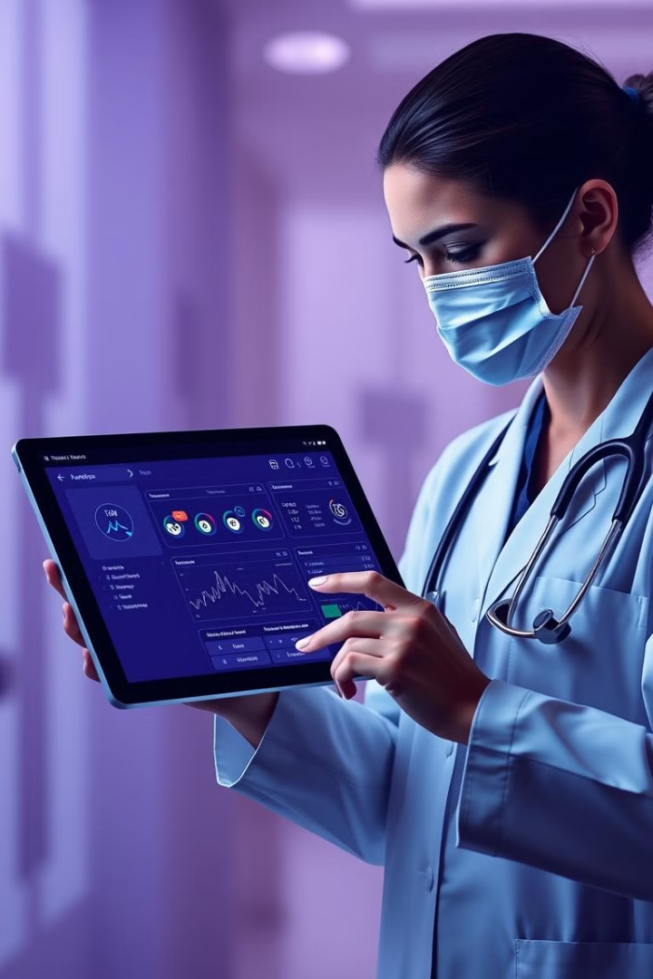




Key Features: Integrated Patient Management
Patient Records
Appointments
Centralized storage and management of comprehensive patient information, including medical history, allergies, and medications.
Streamlined scheduling and appointment management, reducing wait times and improving patient satisfaction.
Billing and Insurance
Clinical Data
Automated billing and insurance processing, simplifying administrative tasks and improving financial management.
Integration with laboratory and imaging systems, providing access to real-time clinical data for informed decision-making.

Slide 5
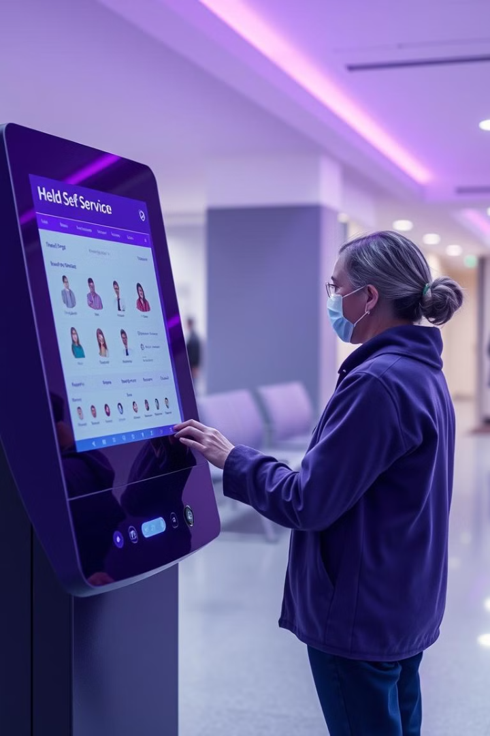



Enhancing Patient Experience
Online Portals
Secure online portals for patients to access their medical records, schedule appointments, and communicate with healthcare providers.
Mobile Apps
Mobile applications for patients to manage their health information, track medications, and access health resources.
Personalized Care
Data-driven insights enable healthcare professionals to tailor treatment plans to individual patient needs.

Slide 6




Ensuring Compliance and Security
Data Security
1
Robust security measures, including encryption, access controls, and regular audits, protect patient data.
Compliance
2
Adherence to industry standards and regulations, such as HIPAA, ensures data privacy and patient confidentiality.
Audit Trails
3
Comprehensive audit trails track all data access and modifications, providing accountability and transparency.

Slide 7
Scalability and Future Scope
Cloud-Based
1
Cloud infrastructure enables scalability and flexibility, allowing the system to grow with the hospital's needs.
Integration
2
Open APIs allow integration with other healthcare systems, creating a comprehensive ecosystem of data exchange.
Artificial Intelligence (AI)
3
AI-powered features can be integrated for tasks such as disease prediction, risk assessment, and personalized treatment recommendations.

Slide 8

Thank you
Thank you for your time. We believe that our HMS can help hospitals deliver superior patient care, improve operational efficiency, and ensure compliance with industry standards.

